Slide 1

Prasanna Karthik Vairam Lecturer Department of Computer Science NUS School of Computing
IT 5007: Software Engineering on Application Architecture
Lecture-3
Notes:
Webinar
Ask questions – raise hand or type questions in Q&A

Slide 2
React: Motivation
Notes:
Webinar
Ask questions – raise hand or type questions in Q&A

Slide 3
What exactly is React?
React may sound like a lot of things.
React is a high level language that generates JS code.
It is just a JS library/script that you include to your HTML file
Digression: What is a Library?
Why is it popular?: React Provides numerous off-the-shelf libraries (components) for you to use. (DOM query, charting, math, etc.)
Importantly: React allows you to create your own custom components from these off-the-shelf components.
More importantly: React defines some nice rules that make coding and debugging easier.
Most importantly: It binds the View and Model to boost performance.
What is the intuition? Netflix example.

Slide 4
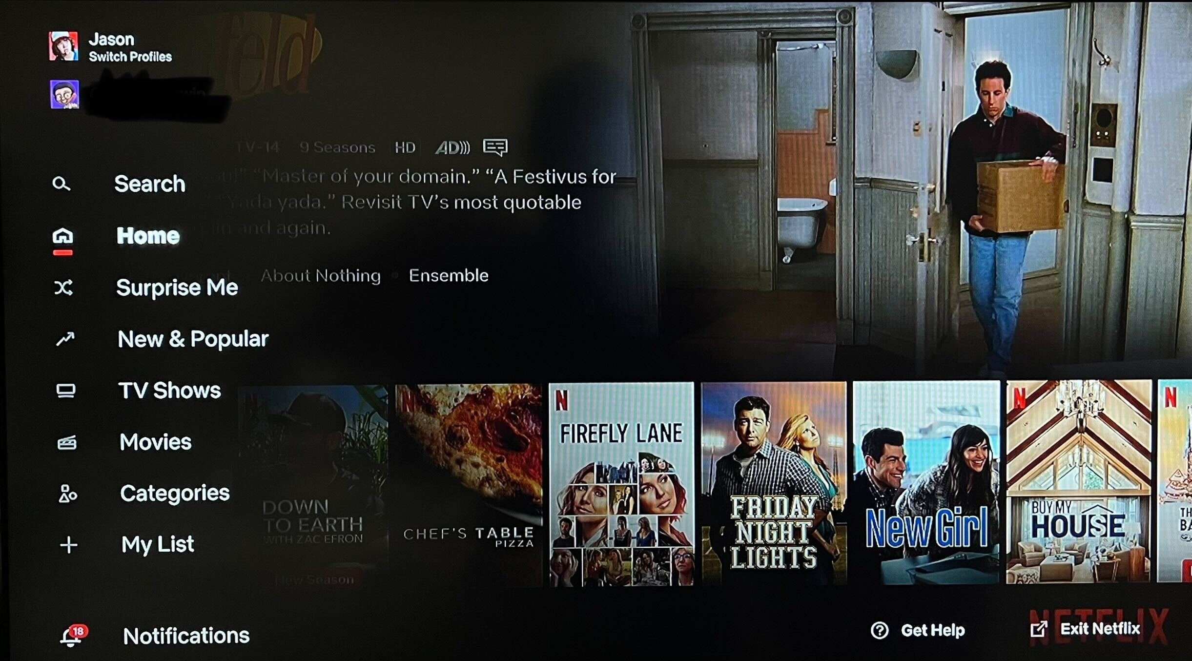
Model-View Dependency

Slide 5



Basics: MVC Model
Control
View
Model
Isn’t this what JS does already?

Slide 6

Javascript: The FB Ad story
Updates
viewed
inputs
Model
View
Control
Manipulates
Curious case of cascading updates!

Slide 7
React: Features
Notes:
Webinar
Ask questions – raise hand or type questions in Q&A

Slide 8
Motivation for React: Component based
Component-1
Component-2
View
View
Model
Model
Components are self-contained and take care of themselves.

Slide 9


Motivation for React: Data flow Rules
Parent Component
Child Component
View
View
Model
Model
Unlike JS, we do not allow data to flow randomly!

Slide 10

Motivation for React: Data flow Rules
That’s like how most developers handle data in JS!

Slide 11


Motivation for React: Isomorphic
Write once – decide where to host later!
Component
User Device
Internet
Server

Slide 12
Motivation for React: Efficiency
Assume you are creating a <table> from the data.
Data Changes
Query to get data
Write data to DOM
Old way
Data changes
Build
New
Virtual DOM
Compare
to old Virtual DOM
Update the difference in DOM
New way
Can you guess what happens in Facebook?

Slide 13
React/JS: JS Class Basics and Class Components
Notes:
Webinar
Ask questions – raise hand or type questions in Q&A

Slide 14
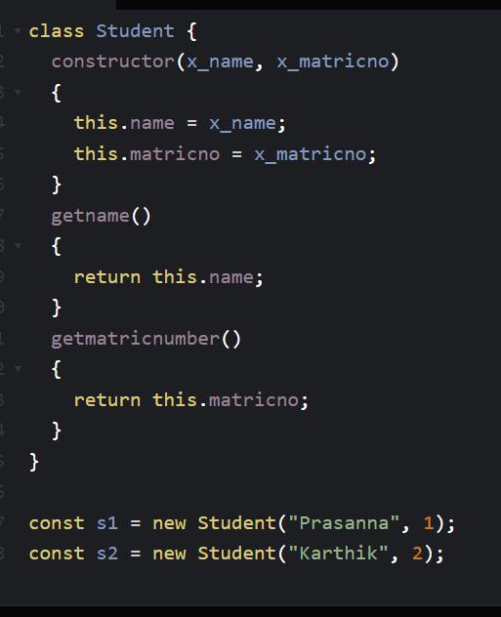
Class Definition
Class is a generic template for creating many objects/instances.
e.g., one Student class template can be used to create 100 real student objects/instances.
Student is the class and s1/s2 are instances.
Constructor is called when an instance is created and its objective is to initialize the object.
A Class can have variables and functions.
this.name refers to the current objects name.
E.g., when s1 is created, this.name refers to s1’s name.

Slide 15
CodePen – Example 1
Example1: https://codepen.io/pkarthik88/pen/oNdjoNm
What is codePen? Is it a software to run react code?
Exercise:
Add one more field (NUSNETID) to student class.
Add get function for new field.
Update the instance creation code (s1 and s2).

Slide 16
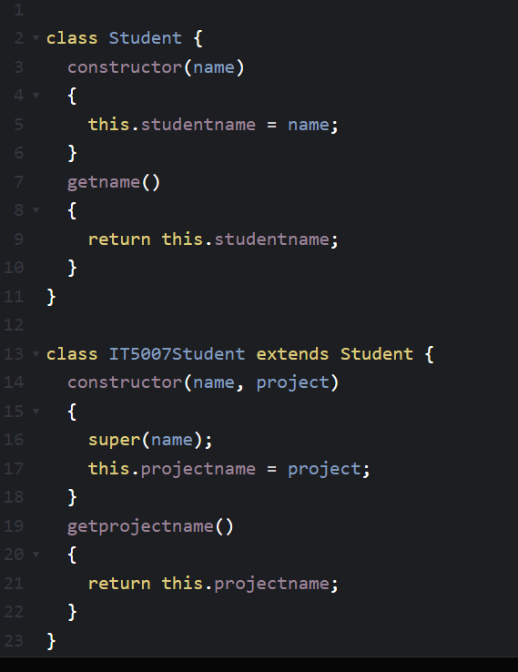
Inheritance
Canvas requires some details of students – Student class
IT5007 may require additional information from students. – IT5007Student class.
The idea is to reuse the variables/functions in Student class and add more variables/functions.
We use extends to inherit from a base/parent class.
Super is used to call the base class constructor. Why?

Slide 17
CodePen – Example 2
Example2: https://codepen.io/pkarthik88/pen/LYmpKQo
Write code to extend IT5007Student class to create a new class called IT5007StudentUnofficial, where you have an additional field called WeChat_ID.

Slide 18
MVC: View (Display)
Notes:
Webinar
Ask questions – raise hand or type questions in Q&A

Slide 19
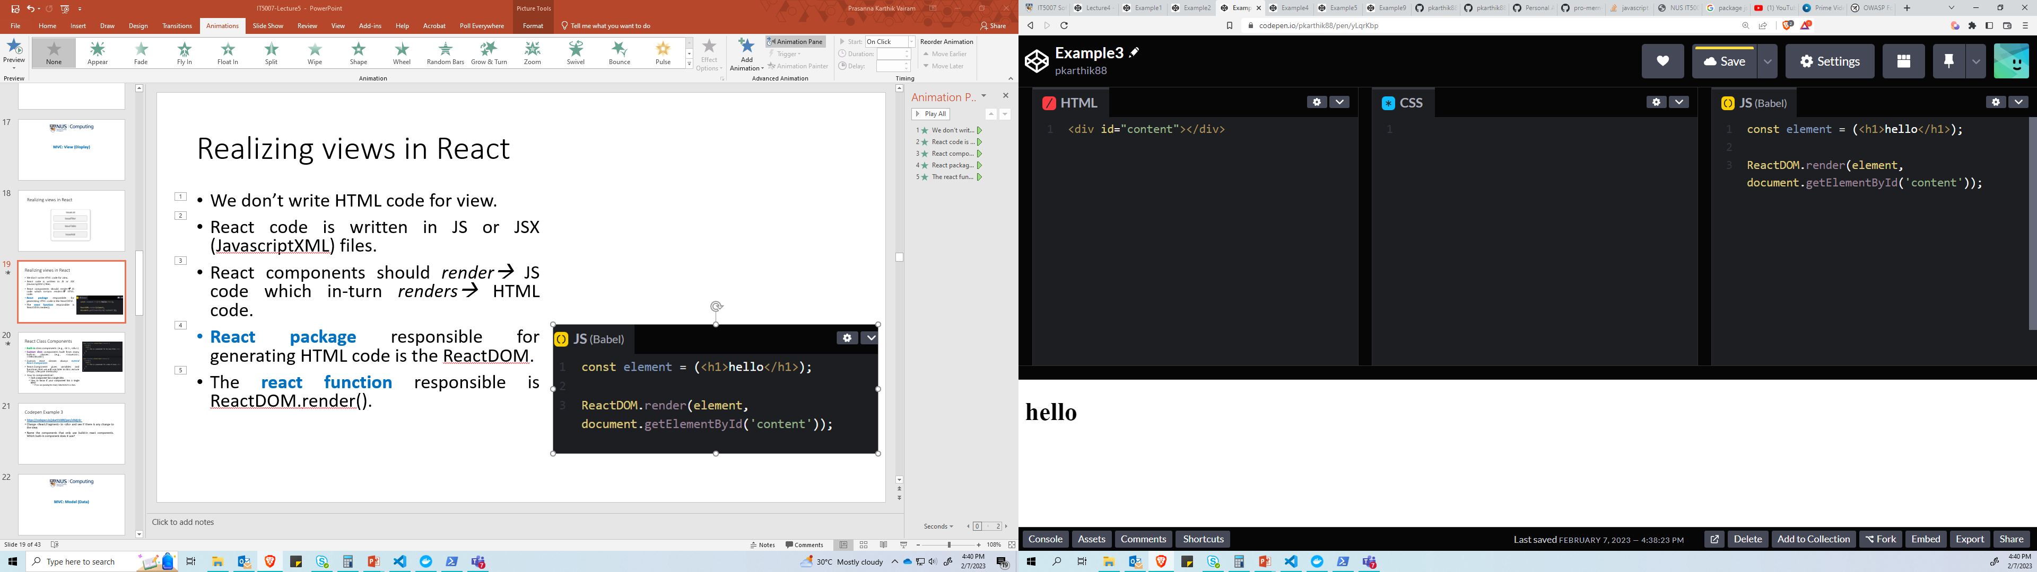
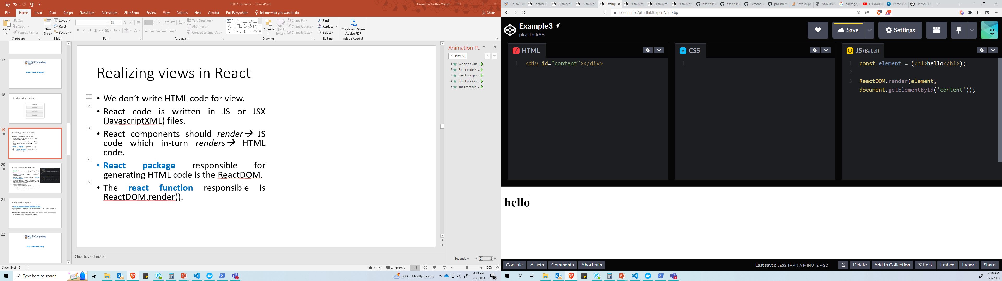
Realizing views in React
We don’t write HTML code for view.
We only create a dummy <div> with an id. Why?
Idea is to allow React to modify the dummy <div> later.
React code is written in JS or JSX (JavascriptXML) files.
React components should render→ JS code which in-turn renders→ HTML code.
React package responsible for generating HTML code is the ReactDOM.
The react function responsible is ReactDOM.render().

Slide 20
Realizing views in React

Slide 21
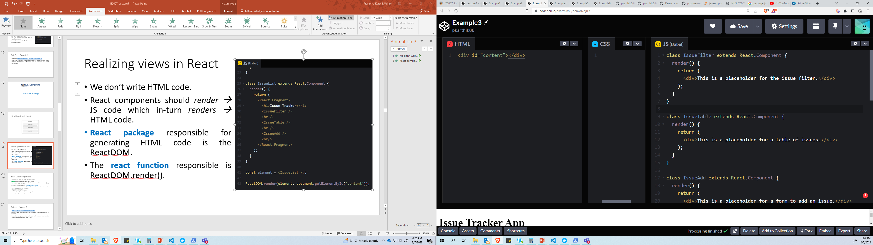
React Class Components
Built-in class components. (e.g., <h1>, <div>)
Custom class components built from many built-in classes. (e.g., <IssueList>, <HelloWorld>)
Custom react classes always extends React.Component.
React.Component gives essential variables and functions that we will use later (Props, Lifecycle Methods)!
How to componentize?
Each component has a single idea.
How to know if your component has a single idea?
If you are passing too many data items to a class.

Slide 22
Codepen Example 3
https://codepen.io/pkarthik88/pen/oNdjrEr
Change <React.Fragment> to <div> and see if there is any change to the view.
Name the components that only use built-in react components. Which built-in component does it use?

Slide 23
MVC: Model (Data)
Notes:
Webinar
Ask questions – raise hand or type questions in Q&A

Slide 24
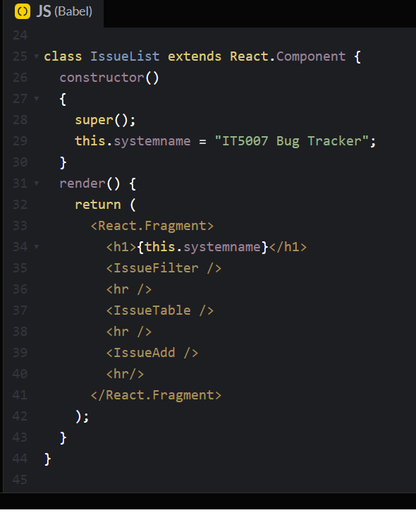
Model-View Integration
Class Component has
render() function that handles view.
Constructor() that handles data.
Integration: We can use JS/React data variables in the view code.

Slide 25
Codepen Example 4
https://codepen.io/pkarthik88/pen/OJZyeem
Create one more class variable called ‘footer’ and use it to add a copyright statement to bottom of the View.

Slide 26
Building Data models in React
Data model is different from database.
DB will be introduced in Lecture 7. For now, let us use simple data-structures that resemble a database (e.g., an array of items).
Data model refers to the structure/shape of data, how they relate to a real-world system, and how they relate to one other.
IssueList is an array of issues.
IssueList has a real-world application called bug tracker.
IssueList is related to EmployeeList the same way as real-world issues/bugs are related to employees.

Slide 27
3 Types of Data in React (Any web/mobile platform)
Domain data: The dataset or static data that your application works with.
For example, Netflix works with a list of movies.
(optional) App State: The current state of the App at this instant of time. As time goes by, the app state will change.
For example, Netflix maintains a list of seen movies, movies that are added as favorites for each user profile.
(optional) UI State: The current state of the Netflix UI. As time goes by, the UI state will change.
For example, Has the user scrolled to the next page?

Slide 28
MVC: Model (Data) for Domain Data
Notes:
Webinar
Ask questions – raise hand or type questions in Q&A

Slide 29
Data Flow rules
a
Parent Component
Child
Component
Grand-child
Component
b
Child
Component
Grand-child
Component
Great-grandchild
Component
Data flow is unidirectional
Data cannot flow from child to parent.

Slide 30
Example: IssueTracker Application
Data is passed down from IssueTable to IssueRow.
Idea is to draw/render one row at a time.
New terms: state, props

Slide 31
Data Modification Rules (Mutation)
B=1
Child
Component
Grand-child
Component
B=11
Child
Component
Grand-child
Component
Data cannot be modified in child component. Why?
Isn’t this a huge restriction? How do we overcome this?

Slide 32
Why is immutability required?
B=1
B=2
Parent
Component
Child 1
B=3
Child 1
Bottomline: This will lead to inconsistencies in data values.

Slide 33
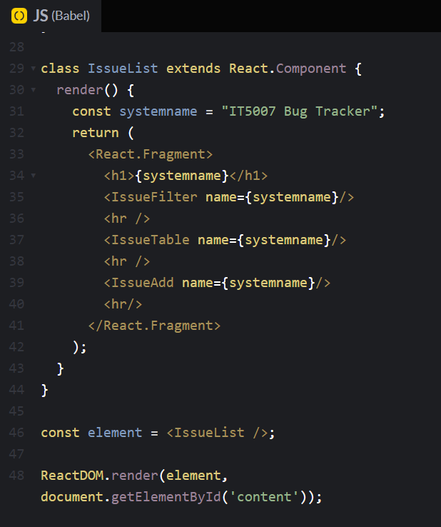
Passing Domain data: props
The idea is to pass some data from a parent to a child.
Props: property attribute.
Parent class passes the variable and its value to the child.
Example: IssueList is the parent trying to pass name={systemname} to its children.

Slide 34
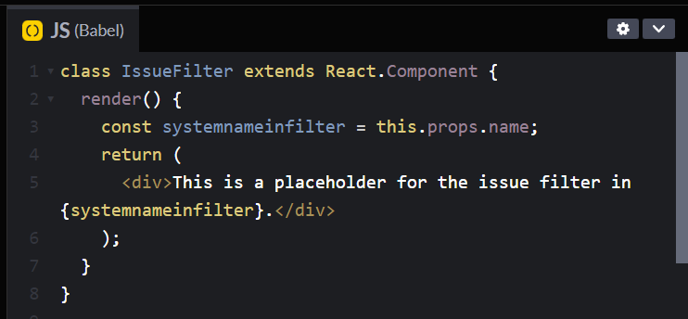
Passing Domain data: props
Child class uses this.props.name to access it.

Slide 35
Codepen Example 5
https://codepen.io/pkarthik88/pen/PoePMZj

Slide 36
React: Function Components (Efficiency)
Notes:
Webinar
Ask questions – raise hand or type questions in Q&A

Slide 37
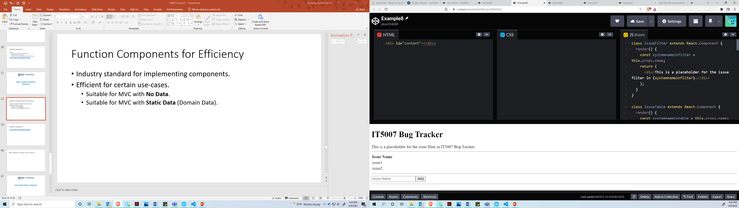
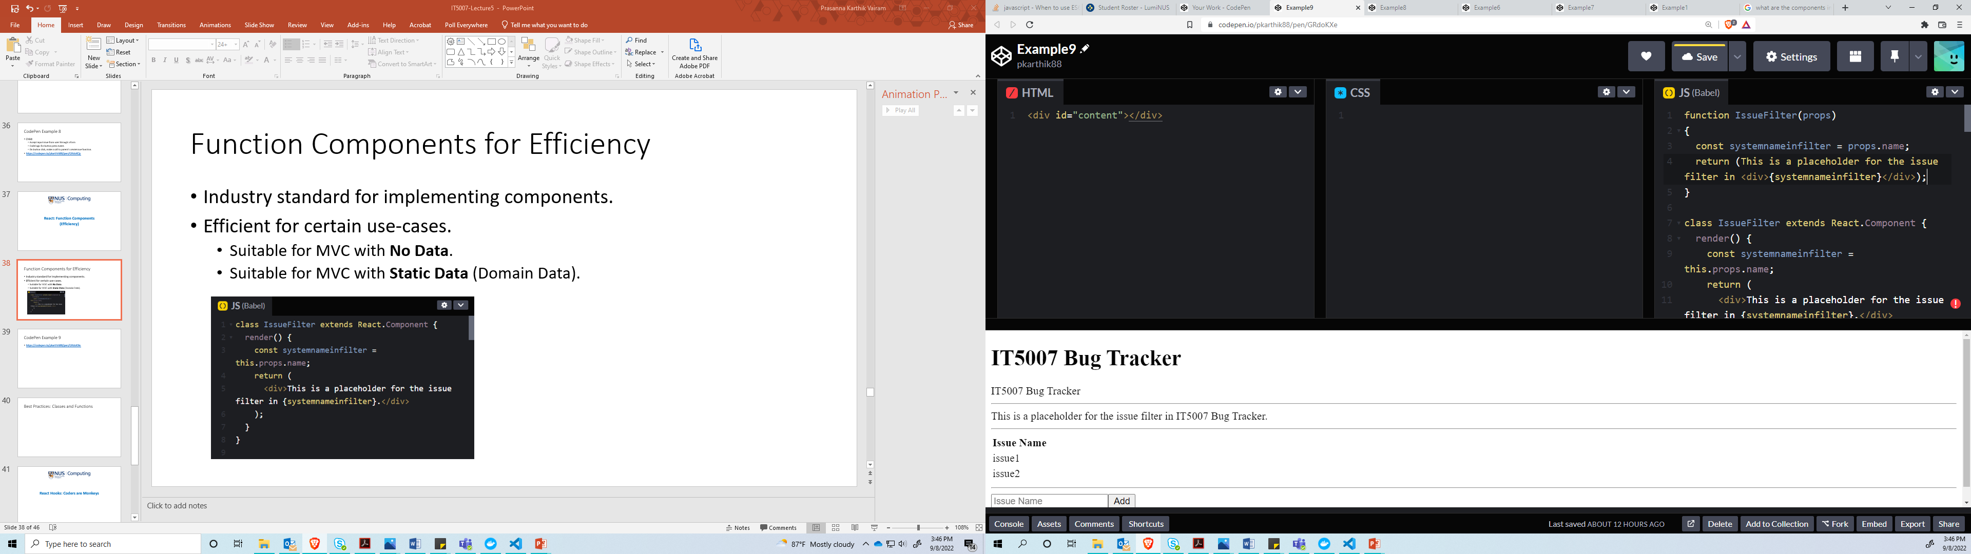
Function Components for Efficiency
Industry standard for implementing components.

Slide 38
CodePen Example 6
https://codepen.io/pkarthik88/pen/YzjMajX
Convert the footer class component into a function component.

Slide 39
The Setup
Notes:
Webinar
Ask questions – raise hand or type questions in Q&A

Slide 40
Developing without Servers
Internet, Server, Client: Are we rich enough to have a server for ourselves?
Instead, Try to emulate the server environment within your laptop.
Our laptop serves as both server and client.
But we need to create a partition between server and client.
Virtualization – VM vs. Containers. We will be using containers.
Server: Docker Container (runs as an application)
Client: Web browser (runs as an application)
Why not just code it like Lecture 2 and Lecture 3? Have all files in one folder and double click on HTML file!

Slide 41
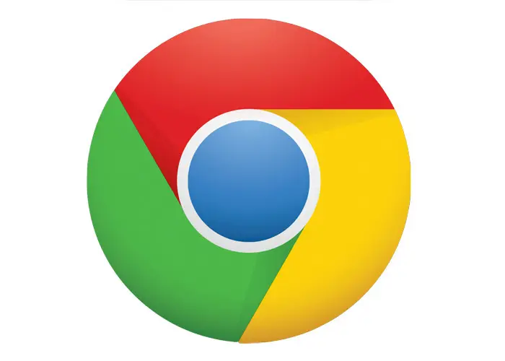
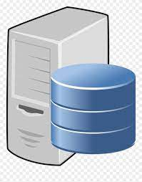

Real World Applications
Web Server
Mongo DB
Client
Server

Slide 42
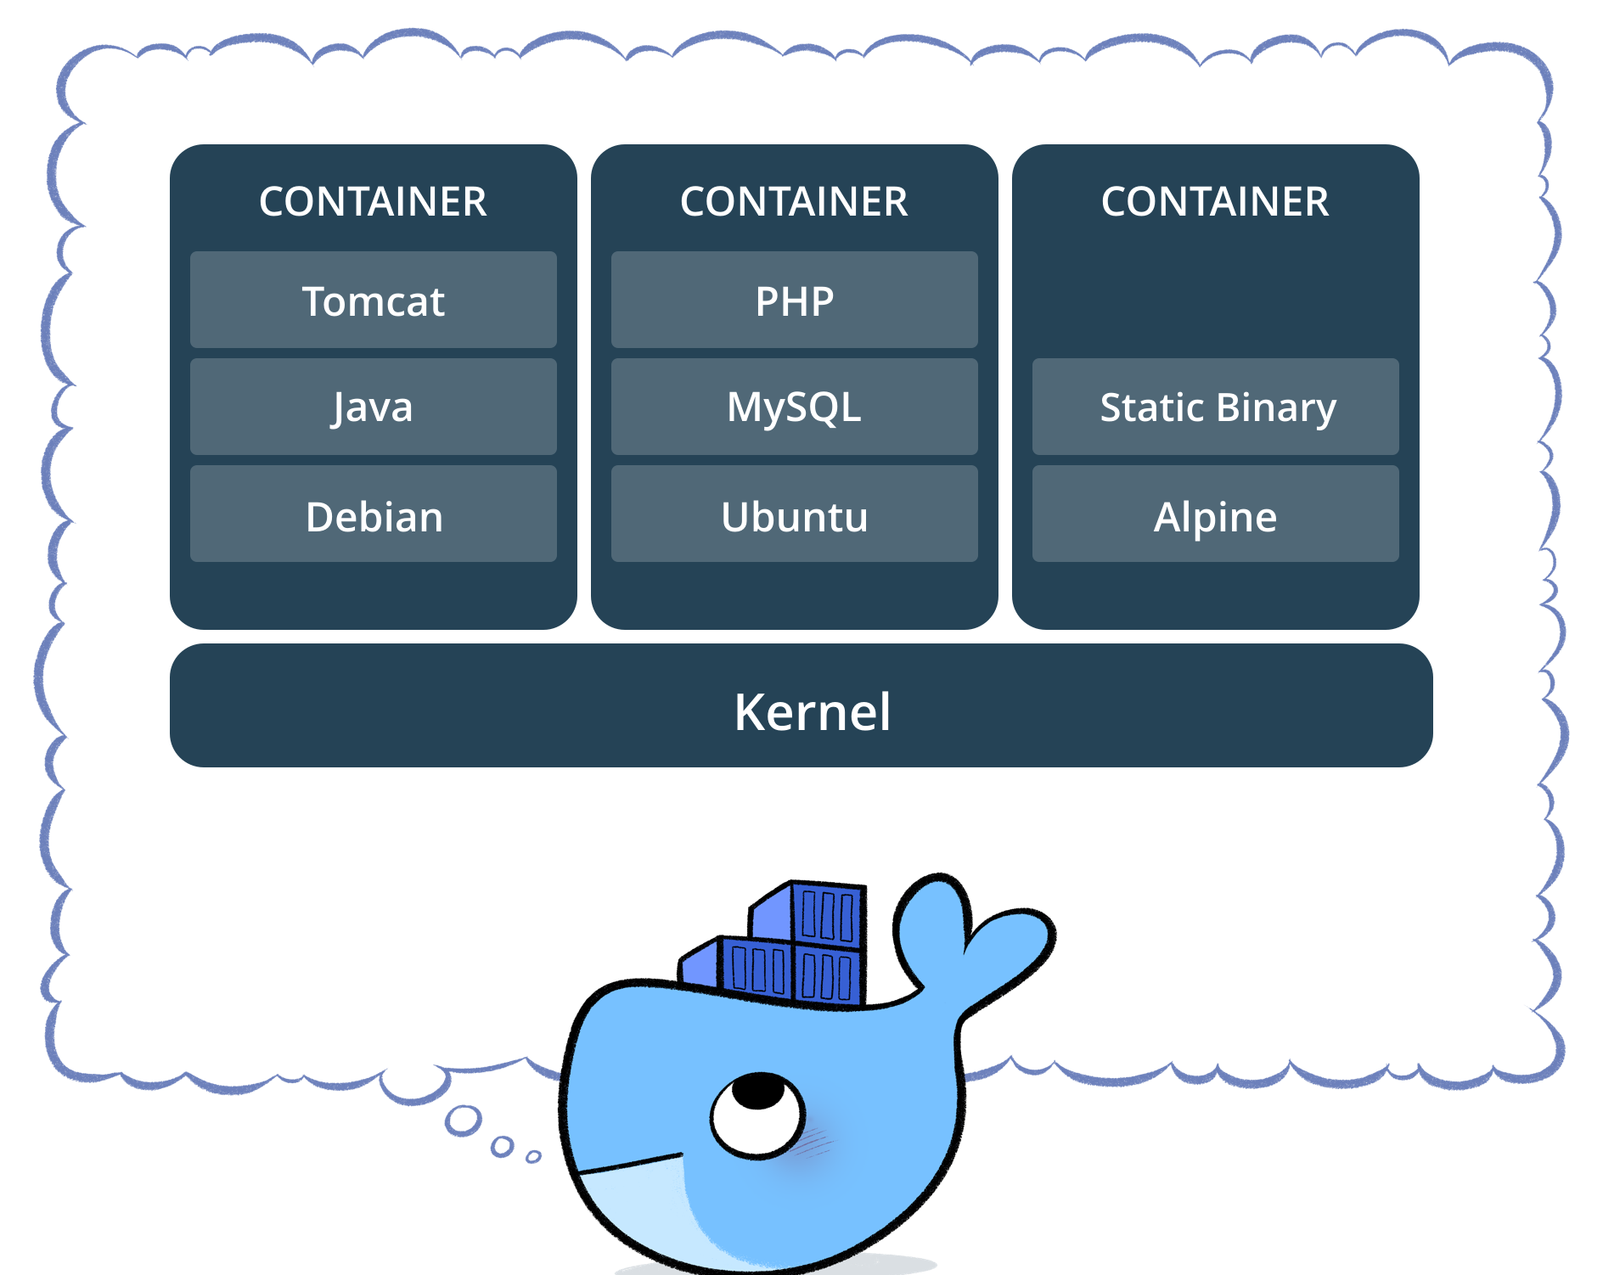

Developer’s Setup

Slide 43



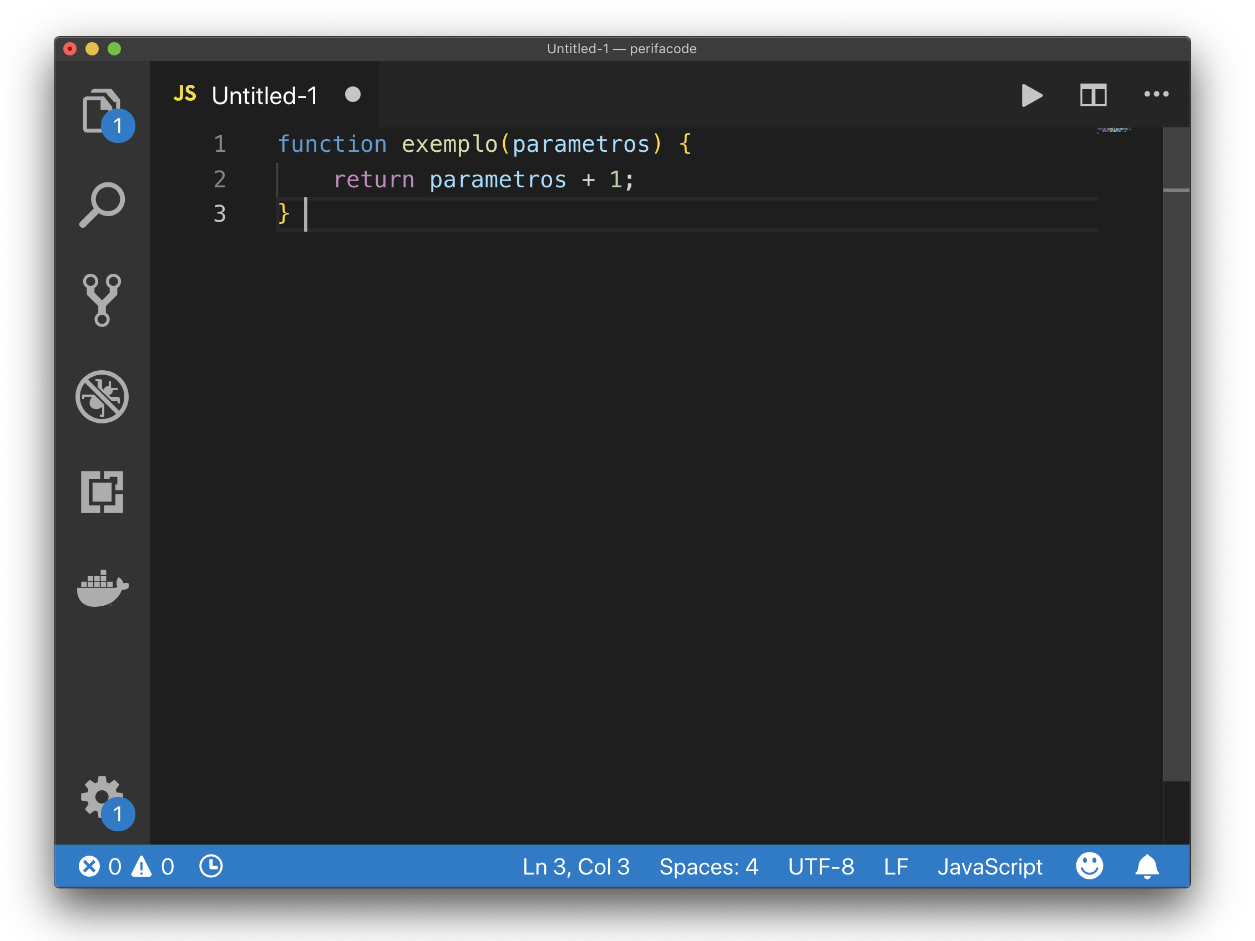
Developer’s Setup
Static Web Server
Mongo DB
Express
This Photo by Unknown Author is licensed under CC BY

Slide 44
Setup Walkthrough Session
Follow instructions in
https://github.com/pkarthik88/IT5007-Lecture5.git
Notes:
Webinar
Ask questions – raise hand or type questions in Q&A

